Slide 1
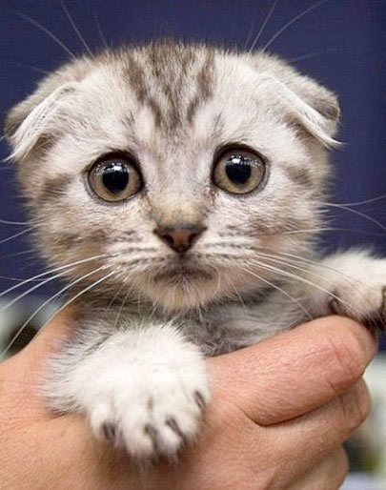
Another presentation?
Meow what am I going
to do?
Work with a Writin’ Titan coach! We help with presentations, too.
Get a pass and come see us today!

Slide 2
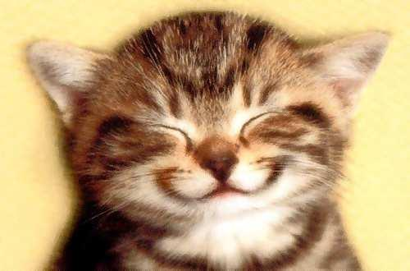
You mean I can brainstorm ideas for my essay with a Writin’ Titan coach?
Purr-fect!
Writin’ Titan coaches can help you at any stage in the writing process. Come see us today!

Slide 3
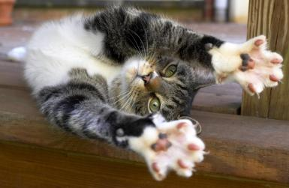
I just revised my essay with a Writin’ Titan coach—
Paw-some!
Even professional authors work with others to revise their writing. See a Writin’ Titan today!

Slide 4
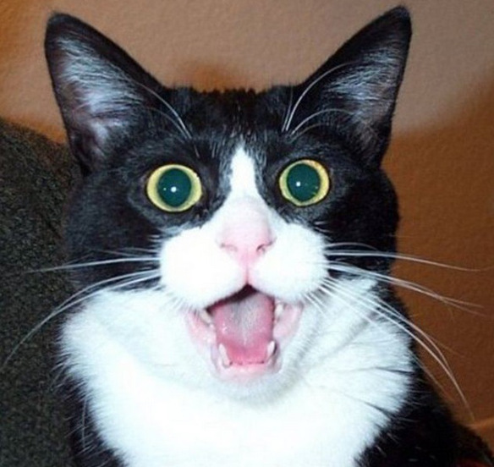
You haven’t worked with a Writin’ Titan coach?
You’ve got to be kitten me!
Writin’ Titan coaches are fun, friendly, and can help you improve your writing!
Come see us today!

Slide 5
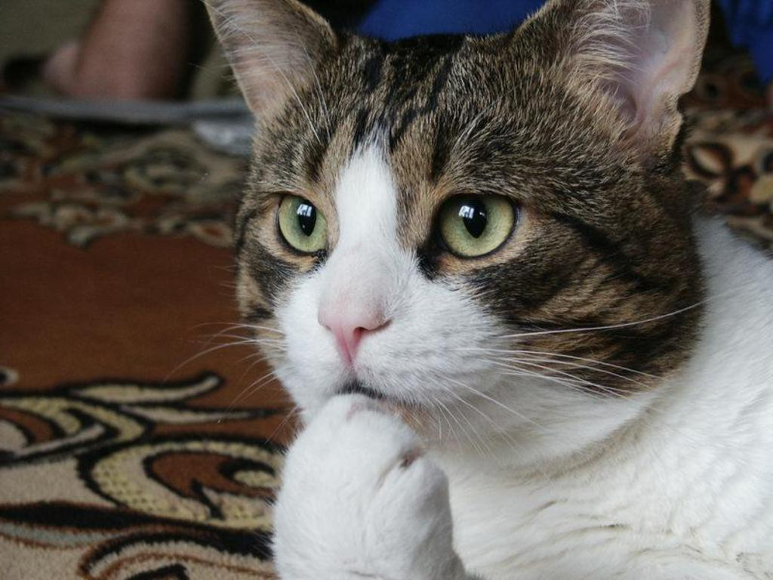
Thinking about working with a Writin’ Titan coach?
There’s no better time than meow!
Anytime is a purr-fect time to visit a Writin’ Titan.
Ask for a pass today!

Slide 6
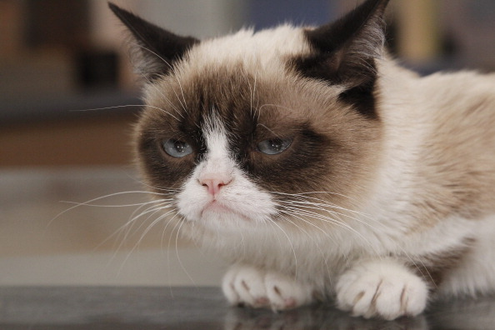
Bad grade on your last essay? Avoid another
cat-tastrophe!
Visit a Writin’ Titan coach! We don’t guarantee A’s, but we’ll do our best to assist you with any speaking/writing-related project.
Get a pass today!

