Slide 1
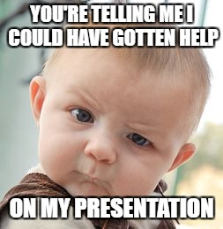
Work with a Writin’ Titan coach
on your next presentation.
Just get a pass from your teacher.
2nd Floor Center Lab—8th Period

Slide 2
Work with a Writin’ Titan coach
on your next presentation.
Just get a pass from your teacher.
JH Computer Lab—8th Period

Slide 3
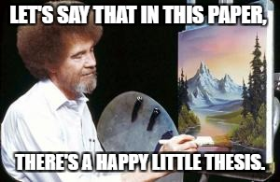
There are no mistakes when you work with a Writin’ Titan-- just happy accidents that could use some revision.
Get a pass and come see us.
2nd Floor Center Lab—8th Period

Slide 4
There are no mistakes when you work with a Writin’ Titan-- just happy accidents that could use some revision.
Get a pass and come see us.
JH Computer Lab—8th Period

Slide 5
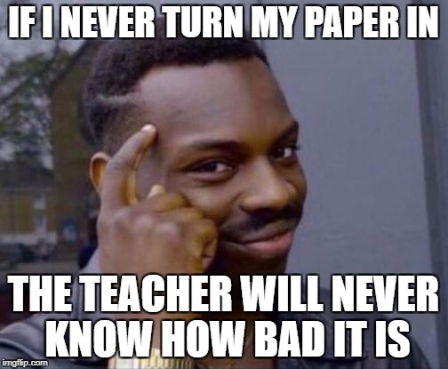
Smart thinking. But, a better idea would be to review your paper with a Writin’ Titan coach.
Get a pass and come see us.
JH Computer Lab—8th Period

Slide 6
Smart thinking. But, a better idea would be to review your paper with a Writin’ Titan coach.
Get a pass and come see us.
2nd Floor Center Lab—8th Period

Slide 7
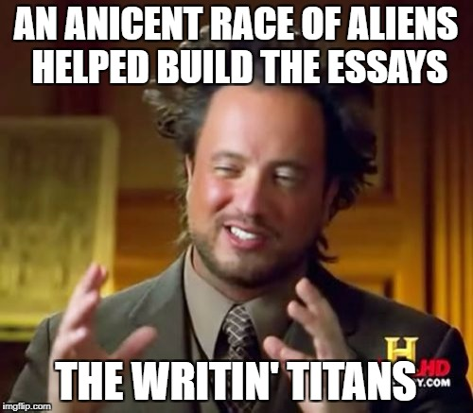
We’ve been around for awhile, but we just made our way over to the high school.
Get a pass and come see us.
2nd Floor Center Lab—8th Period

Slide 8
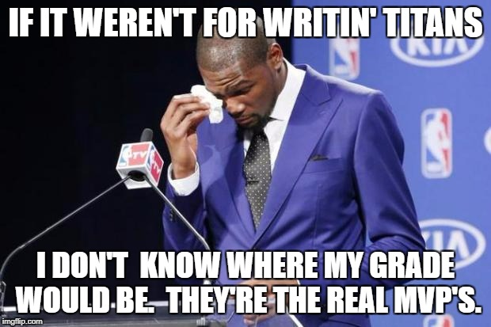
Work with a Writin’ Titan coach
on your next project,
presentation, or speech.
Just get a pass from your teacher.
2nd Floor Center Lab—8th Period

Slide 9
Work with a Writin’ Titan coach
on your next project,
presentation, or speech.
Just get a pass from your teacher.
JH Computer Lab—8th Period

Slide 10
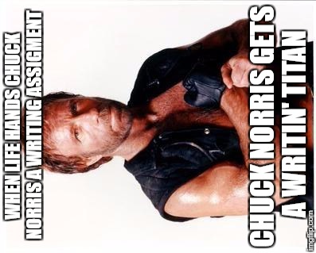
Even tough guys know it’s a good idea to run their work by a peer editor before they turn it in. Work with a Writin’ Titan coach today.
Just get a pass from your teacher.
JH Computer Lab—8th Period

Slide 11
Even tough guys know it’s a good idea to run their work by a peer editor before they turn it in. Work with a Writin’ Titan coach today.
Just get a pass from your teacher.
2nd Floor Center Lab—8th Period

Slide 12
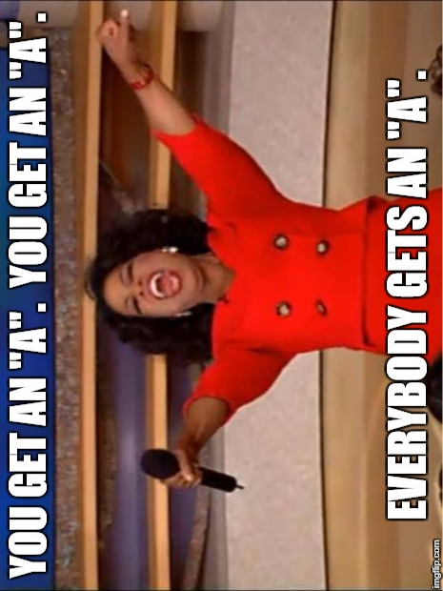
School would be so much easier if everyone just consulted with a Writin’ Titan on their essays, presentations, and speeches.
Just get a pass from your teacher.
2nd Floor Center Lab—8th Period
***Writin’ Titan coaches do not guarantee A’s on all your work. We’ll do our best, though.

Slide 13
School would be so much easier if everyone just consulted with a Writin’ Titan on their essays, presentations, and speeches.
Just get a pass from your teacher.
JH Computer Lab—8th Period
***Writin’ Titan coaches do not guarantee A’s on all your work. We’ll do our best, though.

Slide 14
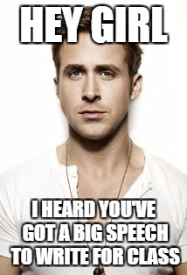
Ryan Gosling is waiting in the Writin’ Titan Room to help you with your next speech.
Just get a pass from your teacher.
JH Computer Lab—8th Period

Slide 15
Ryan Gosling is waiting in the Writin’ Titan Room to help you with your next speech.
Just get a pass from your teacher.
2nd Floor Center Lab—8th Period

Slide 16
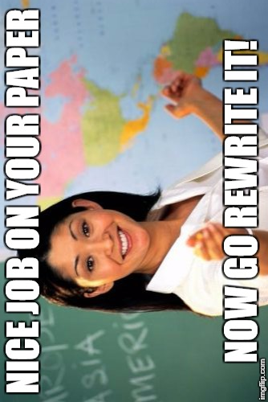
Seriously? Your teacher wants another draft of your paper? Don’t fret. Just get a pass to visit your friendly Writin’ Titan Coaches.
2nd Floor Center Lab—8th Period

Slide 17
Seriously? Your teacher wants another draft of your paper? Don’t fret. Just get a pass to visit your friendly Writin’ Titan Coaches.
JH Computer Lab—8th Period

Slide 18
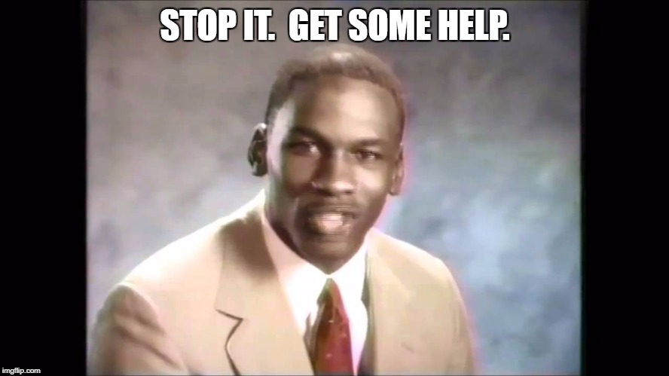
Even professional writers have
editors. So, why not come on down to visit with a Writin’ Titan coach?
Just get a pass from your teacher.
2nd Floor Center Lab—8th Period

Slide 19
Even professional writers have
editors. So, why not come on down to visit with a Writin’ Titan coach?
Just get a pass from your teacher.
JH Computer Lab—8th Period

Slide 20
Writin’ Titan Center
Visit our trained peer tutors for help on essays, papers, presentations, and speeches.
Open Daily—8th Period

