Slide 1
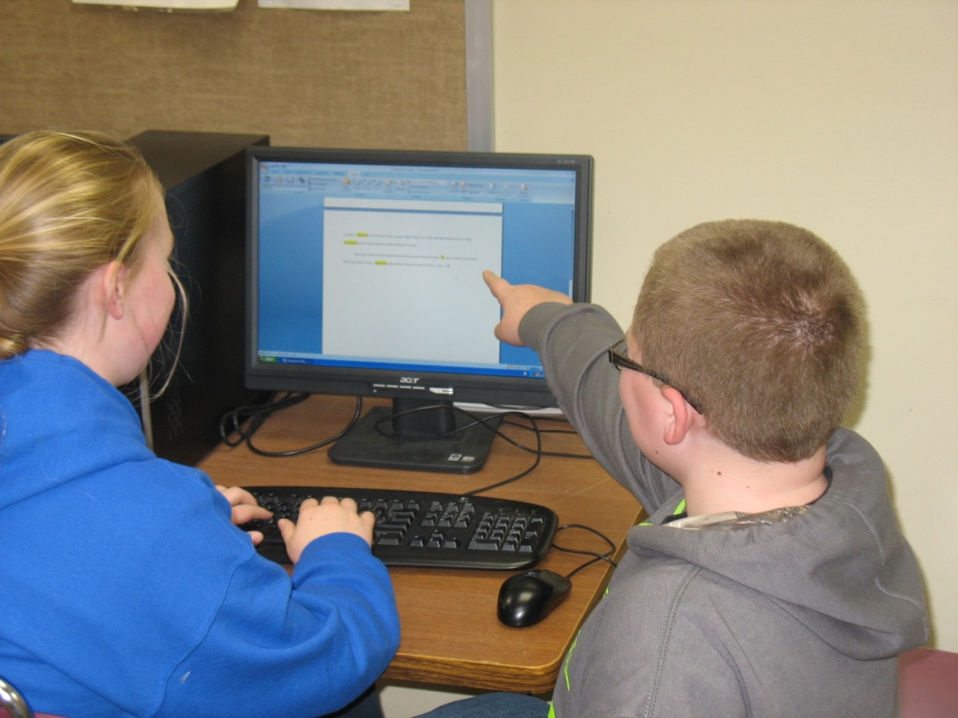
A Student-led Writing Center in Action: The Writin’ Titan Program by Rich “The Grammar Hammar” Martin, Nathan “Mad Dog” Donaldson, Brayden “Brubbles” Krug, and Carson “No Nickname” Lane

Slide 2
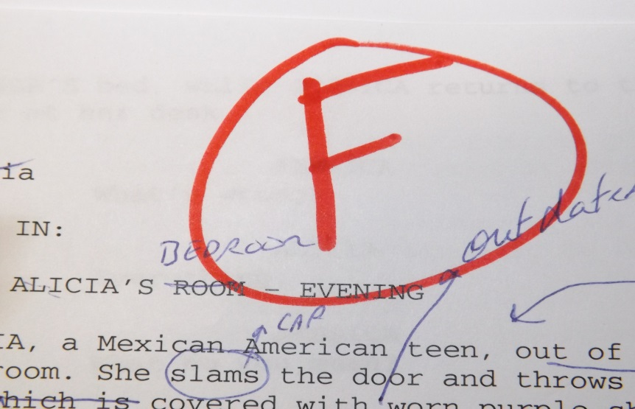
Evidence of a Dilemma
So many students, too little time
Papers and project heading toward F’sville, and I wasn’t doing anything about it
Reluctance of students to self-/peer- edit
work
www.globalyouthjournal.com

Slide 3
My Questions
How can I get to all the students who require one-on-one assistance with their writing?
What can I do to encourage students to take more of an interest in editing their work?
milliwall.com

Slide 4
My Reading
Stephen North—”The Idea of a Writing Center”
Jeff Brooks--“Minimalist Tutoring: Making the Student Do All the Work”
Rich Kent--A Guide to Creating Student-Staffed Writing Centers: Grades 6-12
Pamela B. Ferrell--The High School Writing Center: Establishing and Maintaining One

Slide 5
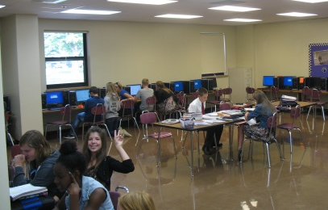
My Reading, Cont.
Rich Kent— “Writing centers... are places where writers talk with fellow writers about their work in an effort to discover a thesis, overcome procrastination, develop ideas, create an outline, evaluate a draft, or revise a draft. Writing center staff members support, tutor, and confer with writers in an effort to encourage and motivate.”
Nancy Grimm identifies three common objectives writing centers share:
1) A good tutor makes the student do all the work.
2) The ultimate aim of a tutorial is an independent writer.
3) Our job is to produce better writers, not better writing.
Notes:
Rich: Through my reading, I gained a fuller picture of what happens in a writing center. I learned that a writing center that just focuses on editing and proofreading is being under utilized. This is what the Kent quote addresses. Student-led writing centers are all about students helping each other through the writing process through collaboration. The power of students collaborating is something that hadn’t occurred to me. Anyone’s writing is improved by bouncing ideas off others. The writing center shouldn’t be a “fix it” shop, it’s a thinking shop. One point that Kent makes is that even professional writers have editors—people who help them find direction in their work and hone ideas. Why should it be any different with student writers?

Slide 6
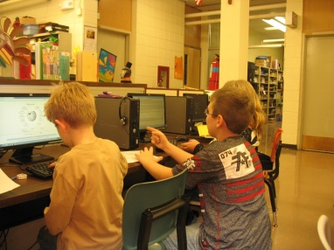
The Writin’ Titan Program
The Writin’ Titan Program was established in September 2013. Since that time, our peer tutors (Writin’ Titan Coaches) have conducted over 800 sessions with grade school and junior high students. In addition, our coaches have been utilized in assisting Special Ed and ESL students.
Our Mission:
To help students become more capable, knowledgeable writers through collaboration
To not just assist writers with the task at hand, but to share and practice skills with writers they’ll find helpful in the future.
Notes:
Carson: Reads slide. Adds, “Again, this is one of our main principles, to not just help the student with their paper, but to impart good writing practices so that our clients become more skilled writers. For example, if a client has a bad introduction that needs revising, we don’t just help them rework the intro, we actually teach them about possible introduction strategies they can use in the future.”
Nathan: Explains picture

Slide 7
Writin’ Titan Coaches
22 seventh and eighth graders
Recommended by teachers as being strong writers, responsible, and friendly
Received training over first quarter, meeting two times a week over lunch
Worked through how to build a good rapport with writers and how to help them with the various stages of the writing process
Notes:
Brayden: Reads slide. Adds, “So, we’ve met in Mr. Martin’s room on Tuesdays and Thursdays during lunch the first nine weeks. We also met once a month over lunch the rest of the year. We got snacks, and Mr. Martin always had some little lesson for us. He usually gave us handouts that we added to our coach’s binder. This is what our binder looks like. We’ll go ahead and pass one around if you’d like to look at it.”
Nathan: Pass around binder

Slide 8
The Writin’ Titan Program—How It Works
1st—
--A student who wants help with a writing assignment requests a referral from their teacher.
OR
--A teacher gives a struggling student a referral.
2nd—
--The coach helps the student over study hall.
3rd—
--The coach records the coaching session in the logbook and reports back to the teacher on the progress that was made.
http://youtu.be/bNWa2IcWi4g
Notes:
Nathan: Reads slide. Adds: “We’ll pass around some sample referrals so you can see what they look like. The teacher writing the referral fills out the front side, and then we fill out the backside after the coaching session and make sure the referral gets back to the teacher. Also, we’ll be showing you a short commercial we created showing how the program works.. This video was shown to all junior high students in their language arts classes to demonstrate how our writing center works.
Everyone: Pass out referrals

Slide 9
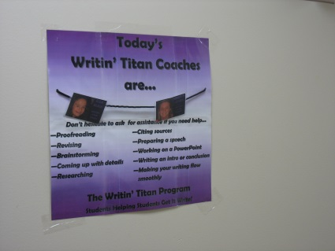
My Teaching
My own teaching changed in several ways:
1) I learned to rely on my coaches to help me work with struggling students, handing students referrals to work with coaches during study hall and assigning coaches to students during class. As a result, I felt less extended and more students received the help they needed.
2) By having to train students in effective tutoring techniques, my own one-on-one teaching skills became much stronger.
3) It’s led me to appreciate the value of collaboration in my own writing.
It also changed my colleagues’ approach to teaching writing. Teachers in my building have come to rely on Writin’ Titan coaches to help them provide additional instruction to struggling writers.
Students, of all skill-level, frequently consult with Writin’ Titan coaches throughout the writing process.

Slide 10
Coaches’ Experiences
Challenges of coaching
Rewards of coaching
Memorable experiences
Effects on own writing
Advice for writing center directors and tutors

Slide 11
Evidence of Change
Individual, case-by-case basis
Increase in number of consultations
Interest from other schools
For year three, I plan to spend more time documenting/assessing the effectiveness of the program
before/after analyses of writing samples, collecting tutor and client interviews, looking for evidence of long-term student growth, and documenting tutoring sessions

Slide 12
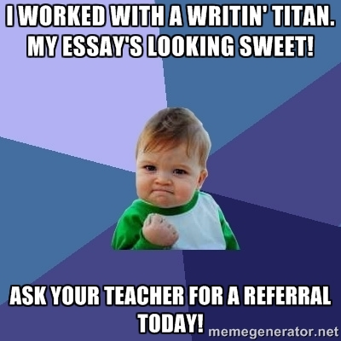
Conclusions
Overall, I believe my students’ writing has benefited from the program. I’ll be looking to document and quantify the WTP’s impact this coming year.
Within my building, coaches and I will continue to promote the value of the WTP and the value of collaboration as part of the writing process.
As co-director, I’ll be working to support existing area writing centers and promote the idea of writing centers to new schools.

Slide 13
Resources
Websites:
www.writintitans.weebly.com
www.ilstatewp.com
www.wcenters.com
My email:
martinr@unit11.org

