Slide 1
The Writin’ Titan Program
Students Helping Students
Get It “Write”

Slide 2
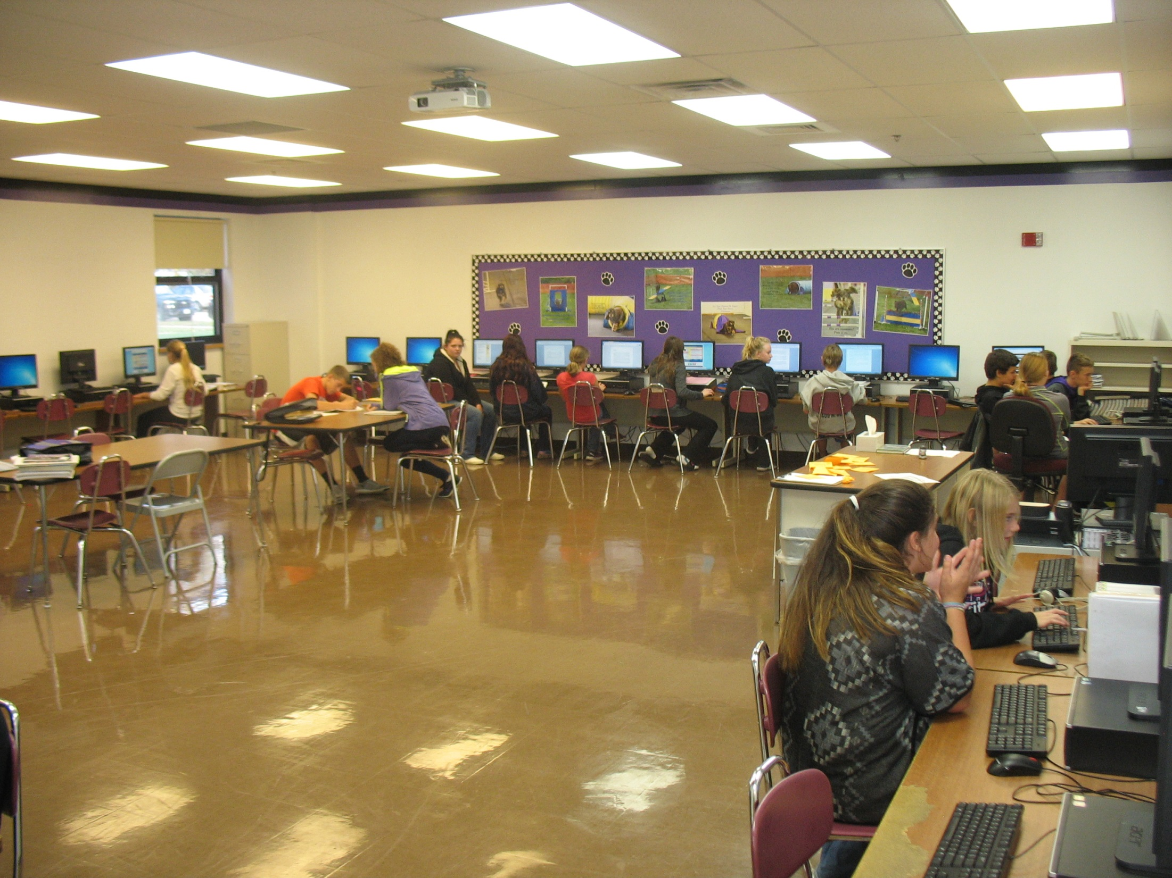
Our Mission
To help students become more capable, knowledgeable writers through collaboration
Our goal is not just to assist writers with the task at hand, but to share and practice skills with writers they’ll find helpful in the future.
(“Give a man a fish/Teach a man to fish”)
Notes:
Allison:
Second Bullet—Give a man a fish, he eats for a day. Teach a man to fish, he eats for a lifetime. We’re working to help classmates over the long term, not just on the paper they’re currently working on.

Slide 3
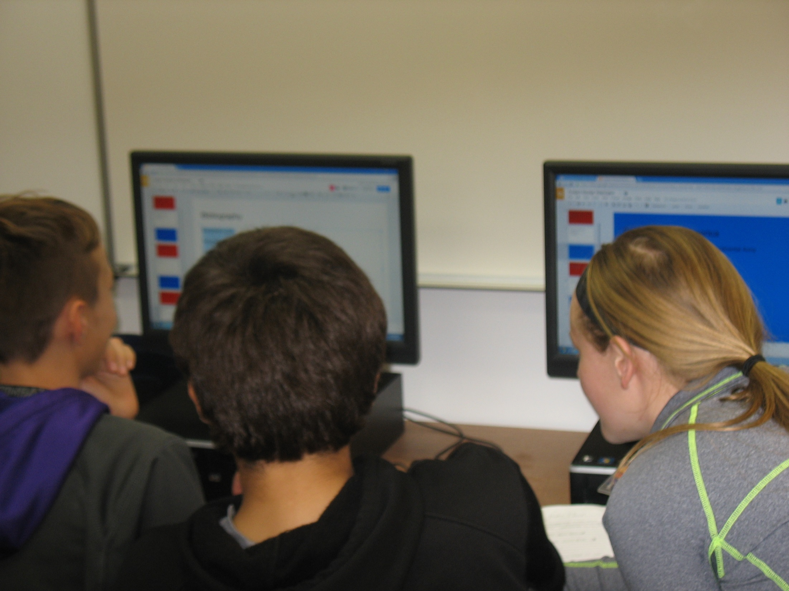
Why The Writin’ Titan Program?
Helps students of all skill levels with writing-related tasks
Brainstorming, Outlining, Researching, Composing, Revising, Editing, Presenting
An intervention for struggling students
Collaboration can lead to better learning
A resource for teachers looking to assign writing
Addresses Common Core Writing Standard #5
An innovative program our school can proudly tout
Notes:
Ashlyn:
First Bullet—This is not just for students that struggle with writing. This is for everyone. Even the strongest writer can benefit from having another person to bounce ideas off of and look over their work. We’ve focused on fighting the stigma that “only struggling students need this.” We say, actually, that only smart kids use this, because if you’re smart, you know that it’s always a good idea to have someone else look over your work. In fact, we often tutor each other.
Third Bullet—Collaboration is an important part of the writing process. When we review our writing with others, we’re able to test our ideas and expression before our work makes its way to its eventual audience. Even professional writers have editors.
Fourth Bullet—Writing can be difficult to teach and difficult to grade. It’s not always possible for a teacher to get to every student who could use individual attention.
Fifth Bullet—This standard states that “With guidance from peers, students should develop and strengthen their writing.”
Sixth Bullet—Our junior high is one of only a handful in the nation that have a program like this.

Slide 4
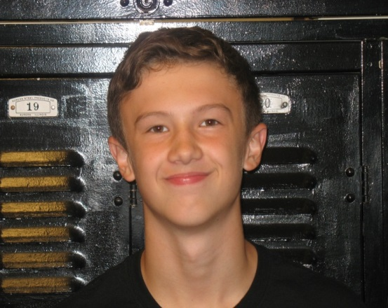
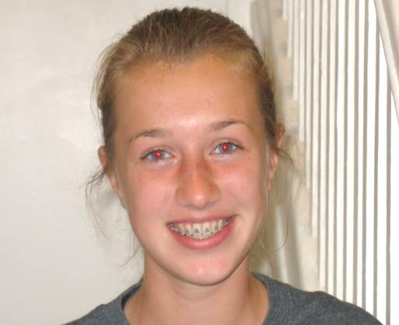
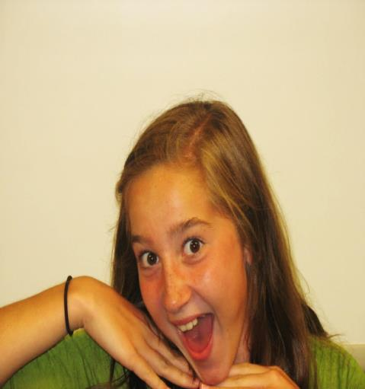
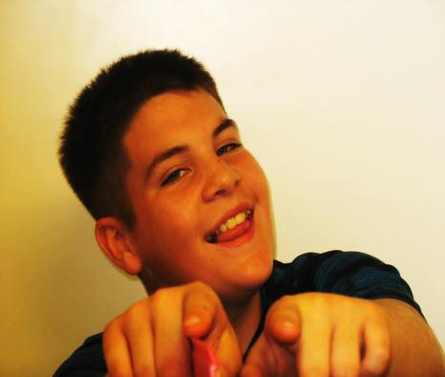
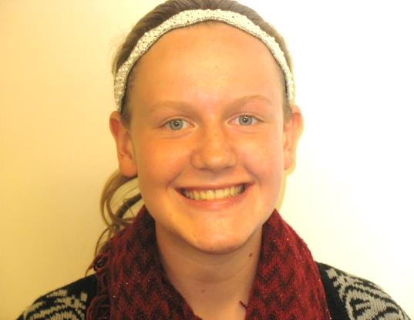
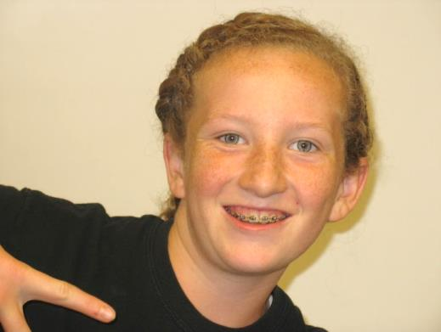
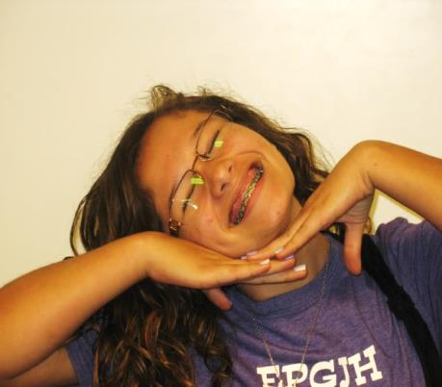
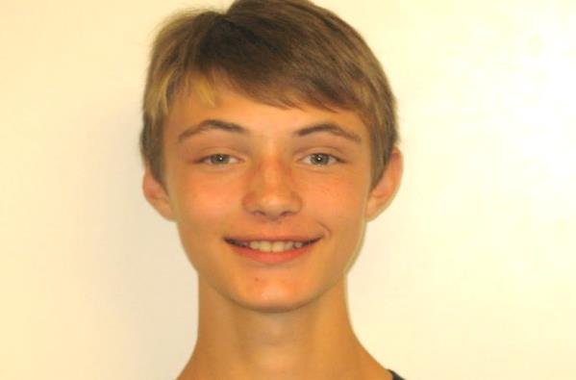
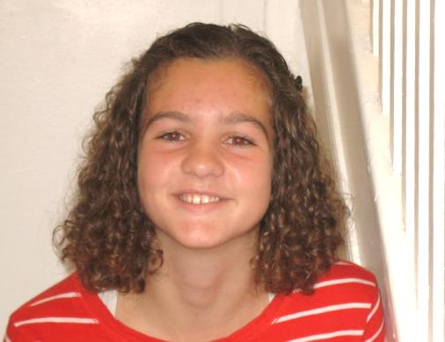
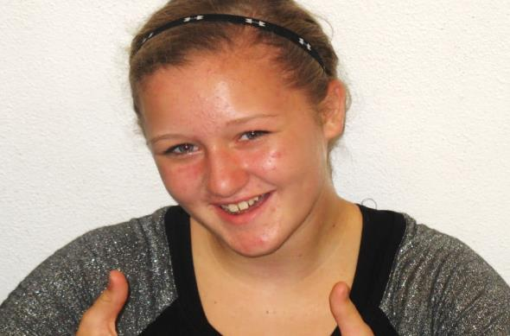
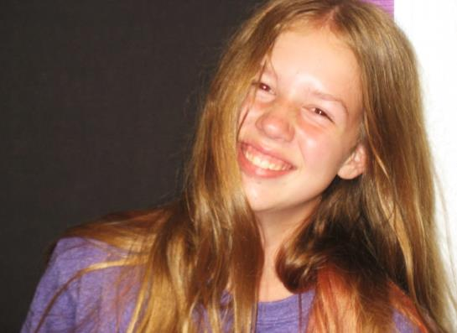
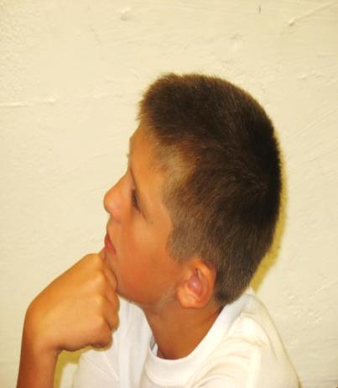
Writin’ Titan Coaches
23 seventh and eighth graders
Recommended by teachers as being strong writers, responsible, and friendly
Received training over first quarter, meeting twice a week over lunch hour. We now hold a meeting each month.
Work through how to build a good rapport with writers and how to help them with the various stages of the writing process
Notes:
Mya:
Say, “We’re called ‘coaches’ because, like a coach, we’re on the sidelines providing advice and strategies. We’re not on the court or field, so to speak, doing the writing. The writer does the writing. We’re just there to provide support.
After this slide is read, each of you should say one thing you remember from training.

Slide 5
How It Works
1st—
--A student who wants help with a writing assignment requests a pass from their teacher
OR
--A teacher gives a student a pass.
2nd—
--The coach helps the student over study hall or lunch.
3rd—
--The coach records the coaching session in our logbook and reports back to the teacher on the progress that was made.
https://www.youtube.com/watch?v=zMLCcMdOV-c&feature=youtu.be
Notes:
Allison reads through the three steps. Then she says: Each year, we create a promotional video that is shown to all the language arts classes in grades 6-8. We’re now going to show you our video from this year, which was directed by 7th grader Ella Newcomb.

Slide 6
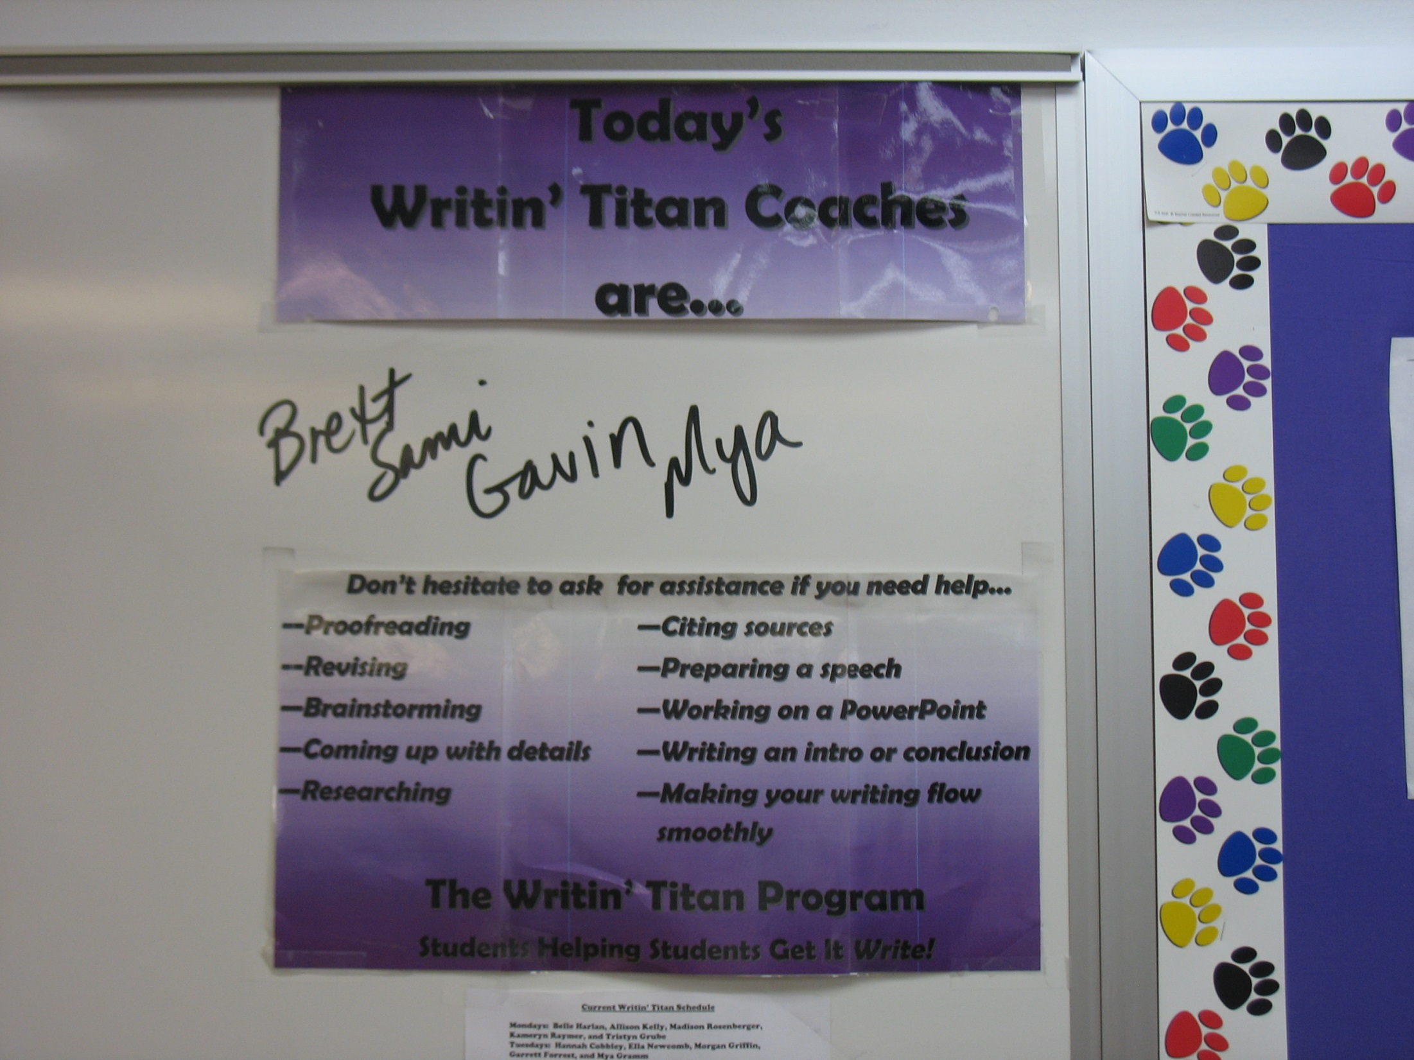
Coaching Guidelines
Here’s What We Do:
1. We help writers at any stage of the
writing process.
2. We work to improve classmates’
writing skills.
3. We keep coaching sessions private.
We treat our clients with respect and
kindness.
Notes:
Mya:
... Whether they haven’t even figured out a topic, or they are in the final stages and just need proofreading help.
... Students can rest assured that only the coach, the student, the teacher will know about a coaching session. We keep things confidential.

Slide 7
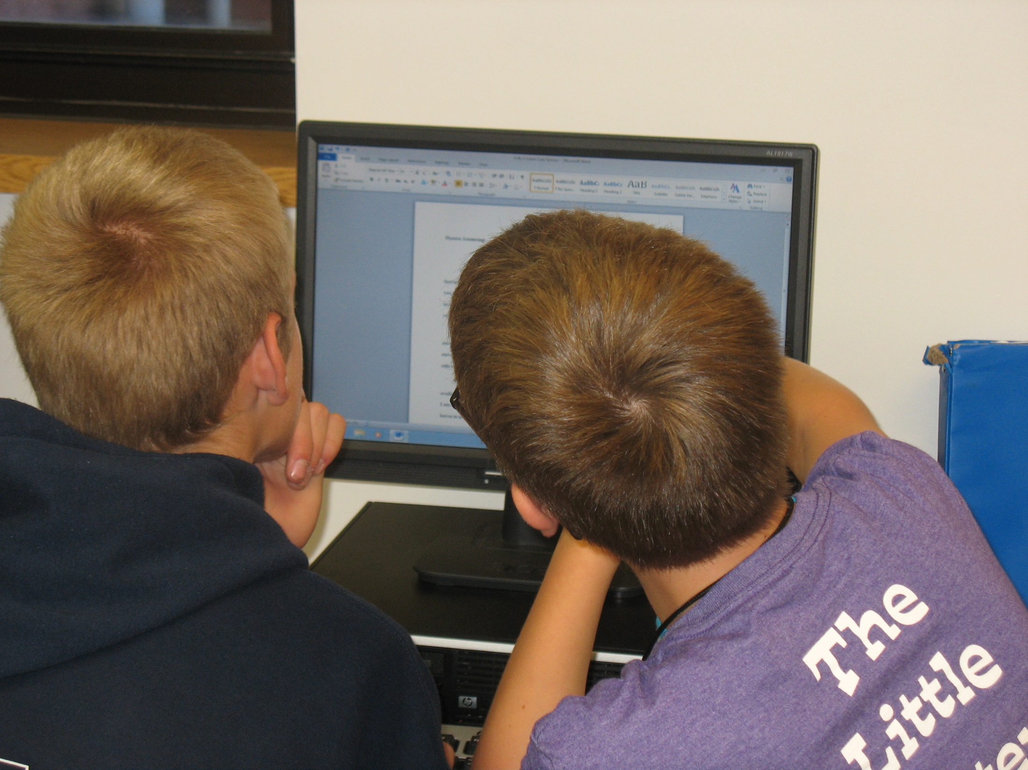
Coaching Guidelines
What We Don’t Do:
We don’t write or fix students’ papers for them.
We don’t put down teachers
or their assignments.
3. We don’t guarantee A’s.
Notes:
Ashlyn:
If possible, we don’t even touch the keyboard (if they’re typing) or the paper (if they’re writing by hand). This is the thing we stress the most; we don’t do the writing. We’re just on the sidelines. It’s vital to our reputation that students and teachers know this.
3. We tell classmates we work with that we’ll do the most we can with the time we have. Often, that’s not enough time to get an entire paper polished.

Slide 8
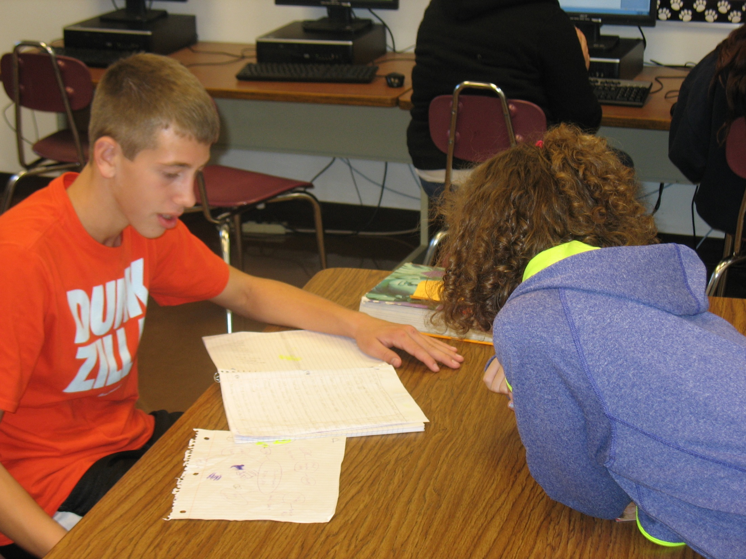
How’s It Going?
Since beginning in October 2013, coaches have conducted approximately 1,000 consultations with 3rd, 6th , 7th, and 8th grade students.
We presented at the Illinois Association for Teachers of English conference last year. In December, we’ll be presenting at the Illinois Raising Student Achievement conference. We’ve also been contacted by teachers from IL, FL, MA, and PA who are looking to set up a program like ours.
Notes:
Allison reads...
After she reads this slide, I’ll ask each of you to share something positive about your experience as a Writin’ Titan Coach.

Slide 9
Visit our website to learn more! www.writintitans.weebly.com
Notes:
Mr. Martin reads. Mya, Ashlyn, and Allison pass out pencils to everyone in the audience.

